Slide 1
BROOM SOLUTIONS: credit card fraud detection
TEAM 2:
DHARMI, SHWETA, KEERTHANA, URVAJ, SUNVID

Slide 2
agenda
Business Problem
Overview
Summary

Slide 3
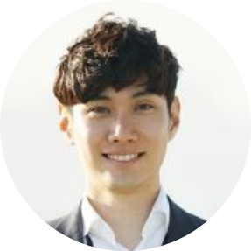
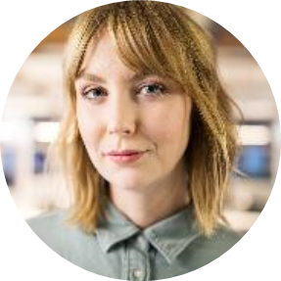
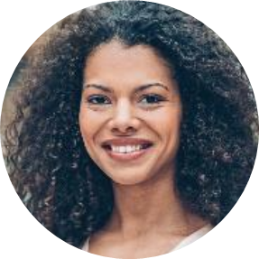
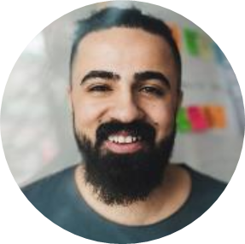
MEET OUR TEAM
Dharmi
Shweta
Keerthana
President
Chief Executive Officer
Chief Operations Officer
Urvaj
Sunvid
VP Marketing
VP Marketing

Slide 4
BUSINESS PROBLEM
Broom Solutions’ current model is
flagging many non-fraudulent transactions
as fraudulent.
As a result, their
retail clients are frustrated
with the
loss of revenue
and customers.

Slide 5
DATA
“It is a capital mistake to theorize before one has data.”
- Sherlock Holmes in “A study in Scarlet” by
Arthur Conan Doyle

Slide 6
TRANSACTIONS PER CATEGORY
Notes:
Run the presentation as it has animations

Slide 7
TRANSACTION AMOUNT

Slide 8
TRANSACTION AMOUNT

Slide 9
TRANSACTION AMOUNT

Slide 10
TRANSACTION AMOUNT

Slide 11
TRANSACTION AMOUNT

Slide 12
TRANSACTIONS PER HOUR

Slide 13
FRAUD DETECTION DATA
 | $USD | £EUR | ¥JPY | ₿BTC
Q1 | 4.5 | 2.3 | 1.7 | 5.0
Q2 | 3.2 | 5.1 | 4.4 | 3.0
Q3 | 2.1 | 1.7 | 2.5 | 2.8
Q4 | 4.5 | 2.2 | 1.7 | 7.0

Slide 14
WEALTH IS THE ABILITY TO FULLY EXPERIENCE LIFE.
-Henry David Thoreau

Slide 15
TYPES OF TOKENS
Payment
Utility
Security
NFT
Gaming
Used to complete transactions anywhere crypto is accepted
These tokens have a specific use within a blockchain
Tokens backed by securities
Authenticates ownership of specific assets
Used as in-game currency and traded with real world value

Slide 16





PORTFOLIO BUILDUP
Step 1
Step 2
Step 3
Step 4
Step 5
Choose a cryptocurrency exchange
Purchase preferred coins & create "wallet"
Research investment and trading options
Stake preferred coins in chosen company
Set exponential growth goals

Slide 17
AREAS OF FOCUS
Portfolio diversification
Short and long-term goals
Develop winning combinations to stay ahead of the market
Capitalize on direct ownership of digital coins
Invest in multiple blockchains​
Create an emergency fund
Add a second stream of income
Buy a house
Supplement retirement fund

Slide 18
HOW TO GET THERE
Strategize
Minimize risk
Utilize resources
Do your research and develop a plan with goals
Diversify your portfolio through coin ownership​
Follow the markets closely​
Be cautious of scams and "too good to be true" scenarios
Avoid "all-in" strategies
Apps and platforms help streamline user experience
Seek expert guidance from Krypto Logics team members​

Slide 19
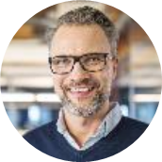
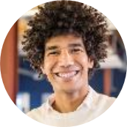
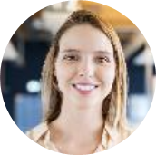
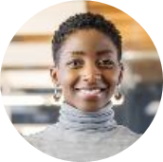
MEET OUR EXTENDED TEAM
Takuma Hayashi​
Mirjam Nilsson​
Flora Berggren​
Rajesh Santoshi​
President
Chief Executive Officer
Chief Operations Officer
VP Marketing
Graham Barnes
Rowan Murphy
Elizabeth Moore
Robin Kline
VP Product
SEO Strategist
Product Designer
Content Developer

Slide 20
SUMMARY
At Krypto Logics, we believe in giving 110%. By using our next-generation data architecture, we help investors virtually manage their portfolios. We thrive because of our market knowledge and great team. As our CEO says, "Efficiencies will come from proactively transforming how we do business."

Slide 21
THANK YOU
Mirjam Nilsson​
mirjam@greatsiteaddress.com
www.greatsiteaddress.com

